Slide 1
POWERED BY ACHROMATIC SOFTWARE DEVELOPMENT
Cricket Player Data Management System

Slide 2
Achromatic
We Are…
Introducing Group Members
Md. Hassanuzzaman(Group Leader)
Ashik Roy
Jisan Uddin Rokon
Fahim Shahriar Chowdhury
Shahin Shimanto

Slide 3
What Does This Program Do?
This program stores the information of the cricket players.
There are two option in the program to choose from, admin or user. By choosing admin one can add, edit or delete any of the data in the database. And by choosing user, they can only see the information in the database.

Slide 4
It can add information of any player in the database.
Admin can Edit/Delete existing players data.
Any user can use the search option to know their desired player’s information.

Slide 5
Now we will know more about the Player Database Program

Slide 6
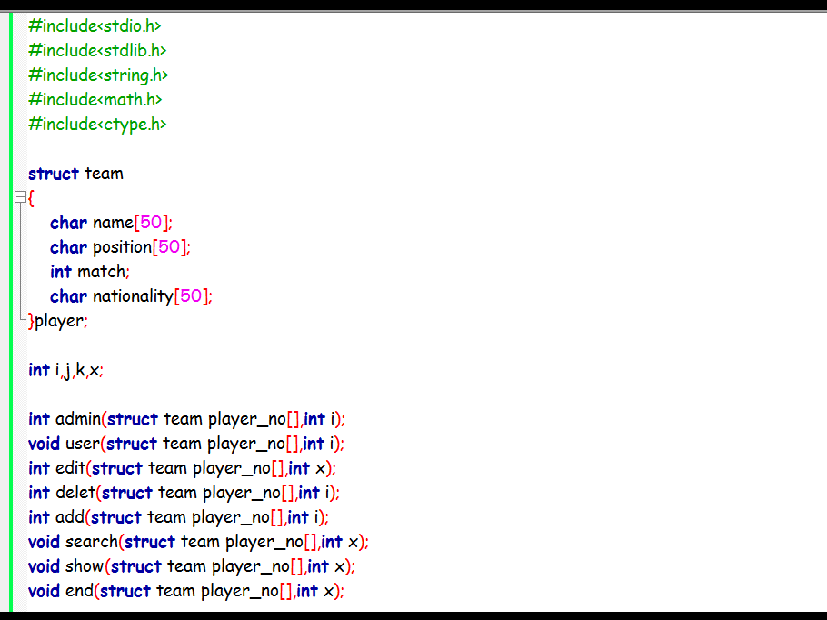
Libraries
Structure
Global Variables
Prototype of the functions
Here we can see the included libraries for the program, The main structure, Global Variables and the prototypes of the functions of the program.

Slide 7
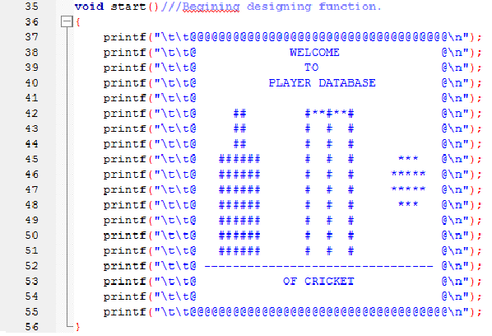
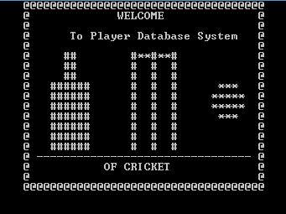
This is the start function
And here is the welcome screen of the program

Slide 8
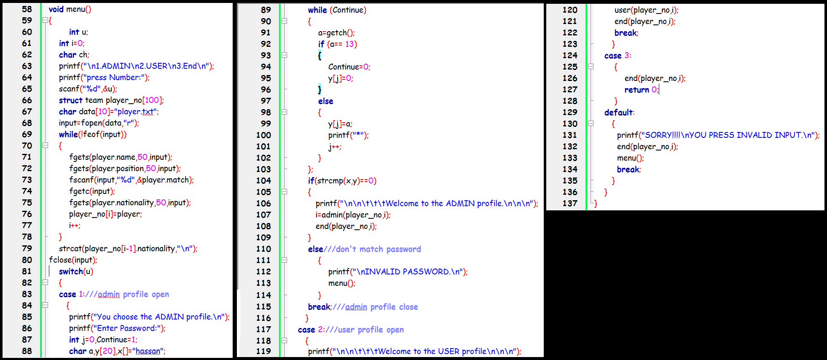

This is the code for the menu of the program
Here is the menu

Slide 9
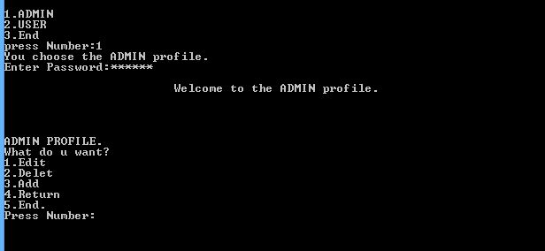
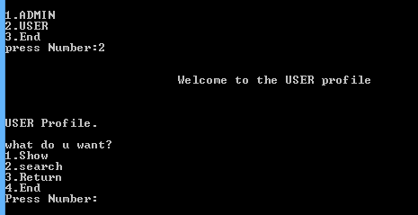
Here admin enters the password
By choosing the ADMIN option from the menu, you have to get through the password to access the Admin Profile.
User will choose the USER option in the menu to see and search through the information in the database.

Slide 10
The Admin Profile
……Breakdown
Edit, Delete and Add option

Slide 11
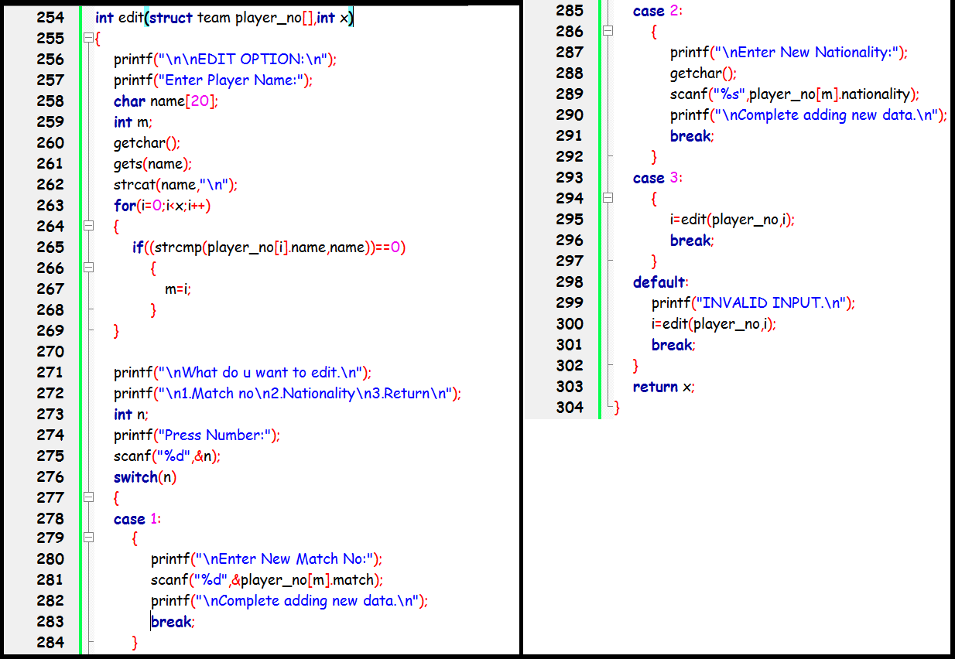
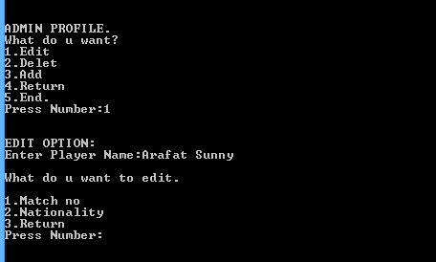
Here is the code for the edit funtion.
In the program admin can edit the information of any player in the database by choosing Edit.

Slide 12
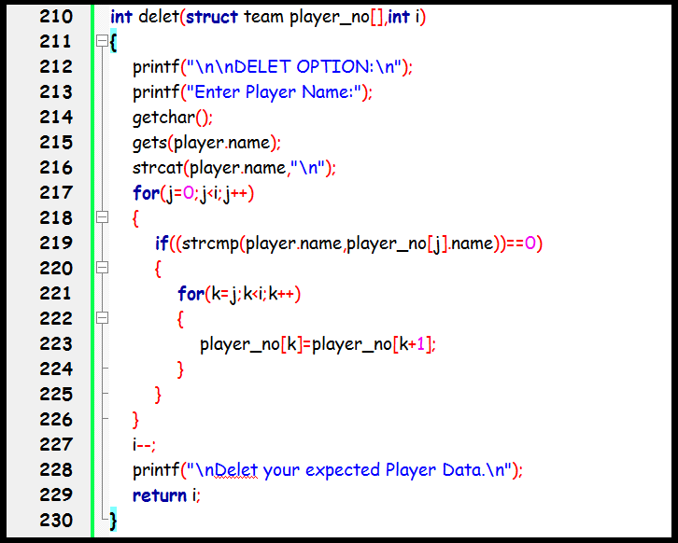
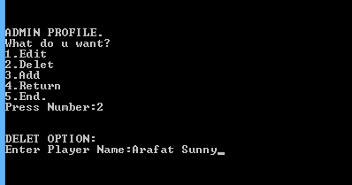
This is the code for the delete function.
By entering the name of the player in the Delete option of the program admin can remove the player from the database.

Slide 13
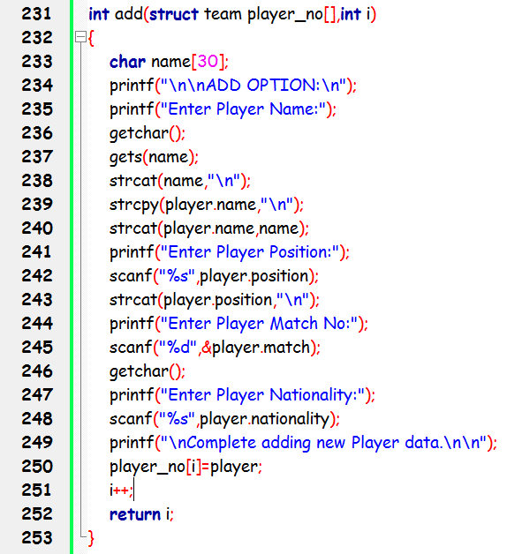
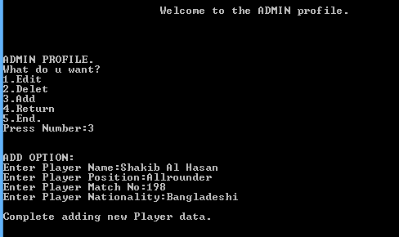
This is the code for the add function
In the program , from the admin profile we can access the Add Option. Then we can add new player and his information in the database.
Data added

Slide 14
The User Profile
……Breakdown
Show and Search option

Slide 15
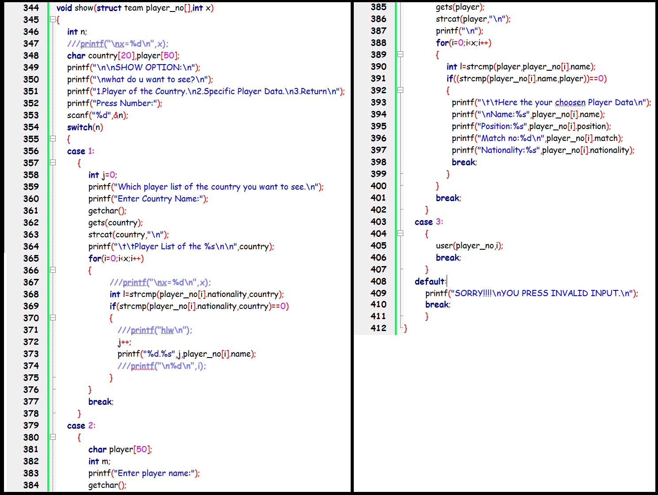
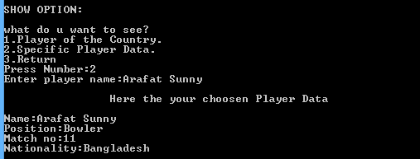
Here is the code for the show function.
By choosing the SHOW from the user menu user can see any player’s full information by entering the player’s name.
Showing player information

Slide 16
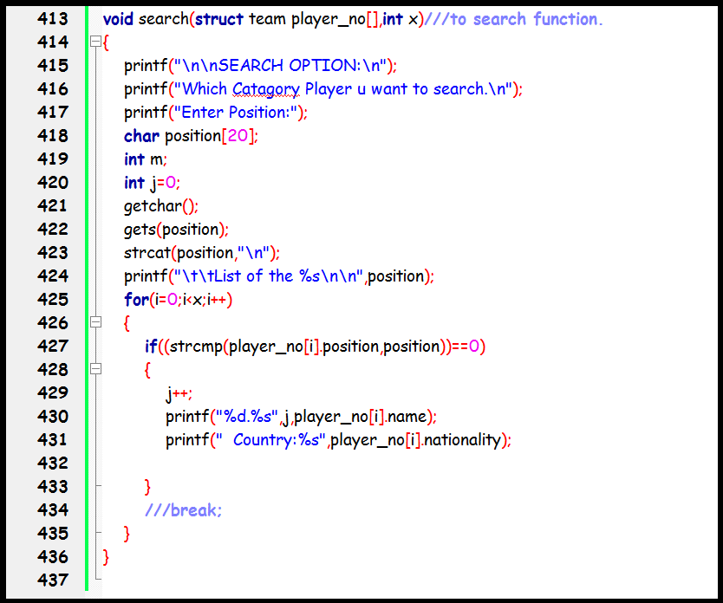
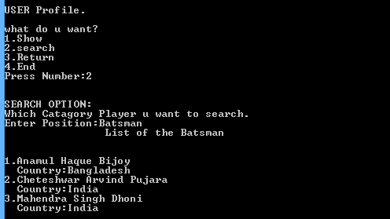
Here is the code for the search function.
After choosing the search option user can search any player in the database by position.
Showing player information

Slide 17
End of the presentation
Thank You For Your Patience
Any Questions?
Presentation Created by: Md. Hassanuzzaman

